Slide 1
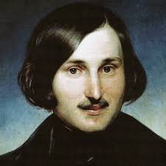
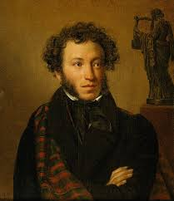
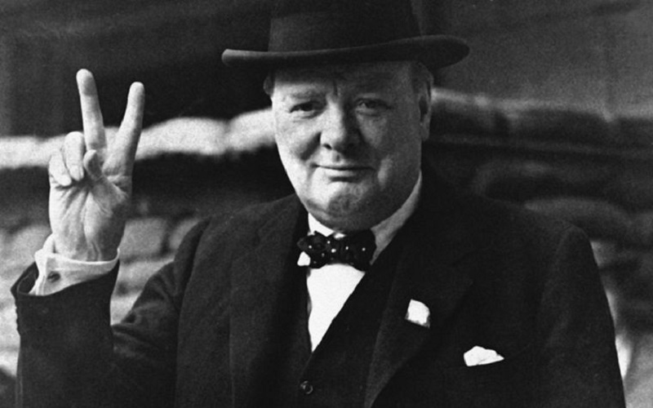
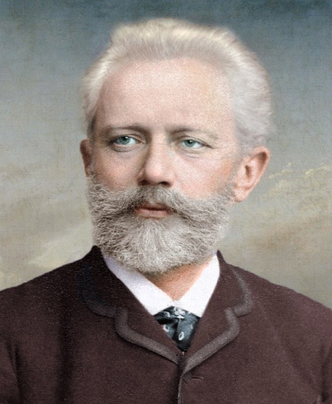
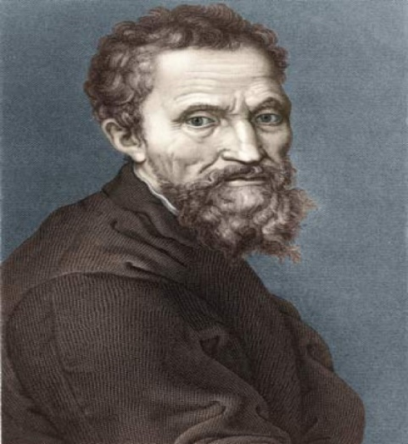
1. Listen to the dialogue and repeat .
A writer-писатель
А poet-поет
A politician-политик
An artist- художник
-Who was Nikolay Gogol?
-He was a famous writer.
-When was he born?
-He was born in 1809.
-Was he English?
-No, he was Russian.
Well-known- хорошо известный
Great- великий
Outstanding- выдающийся
2. Make up the dialogues about each person as in the example above and write them down.
Pushkin
Tchaikovsky
Michelangelo
Churchill

